Slide 1


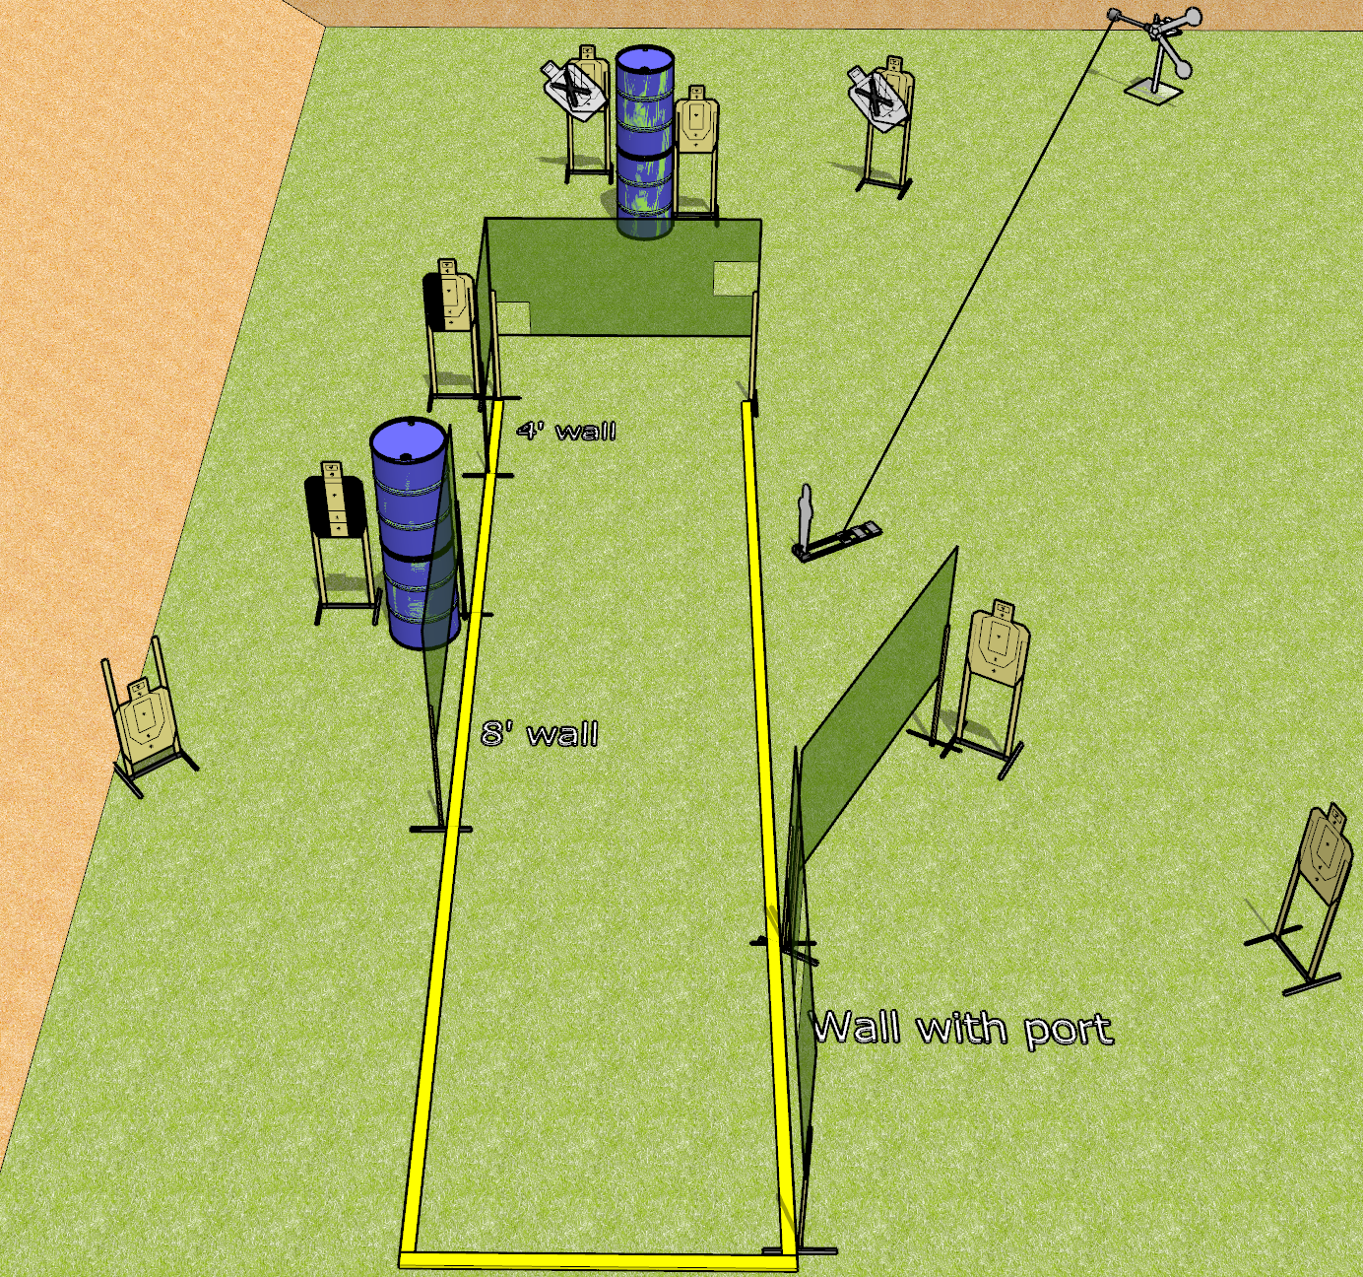
 | Dothan Gun Club – USPSA Match Sidekick Course Designer : Drew Coleman
Round Count 18 rounds 8 USPSA 2 steel
Equipment List Red Stich target + activator + mini popper OR stomp box

Slide 2
Sidekick
Written Stage Briefing
Sidekick is an 18 round, 90 point, Comstock course of fire. There are 8 USPSA targets, and 2 falling plates. The best 2 hits on paper will score, and steel must fall to score. The start signal is audible.
The swinging plates must be activated before being engaged. They are activated by the knock down popper/stomp box.
Handgun start position is anywhere outside the shooting area, wrists below belt. Handgun is loaded and holstered.
PCC start position is anywhere outside the shooting area, stock on belt. Carbine is loaded, safety on.
On start signal, engage targets as they become available from within the shooting area.

